Slide 1



Photoevaporating Protoplanetary Disks near Young Massive Stars in the Orion Nebula
Mackenzie James
Mentor: Dr. Jinyoung Serena Kim
Arizona Space Grant Symposium, April 14th, 2018
Notes:
JSK: Title is a bit too large and your name is too small.
I changed font size a bit.
What about using different colors for name or title?

Slide 2
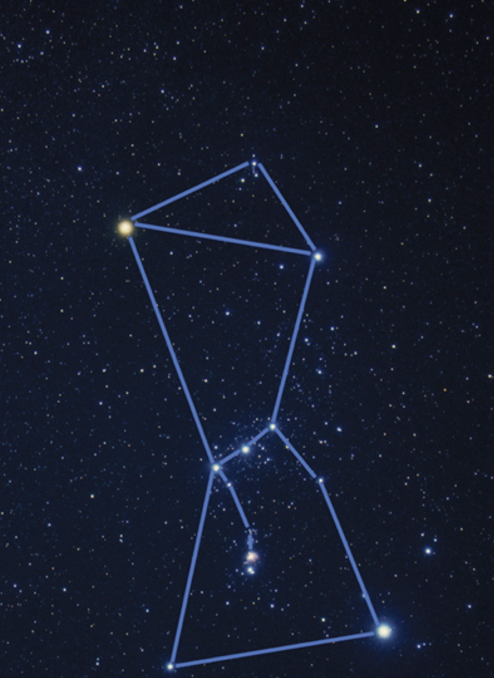
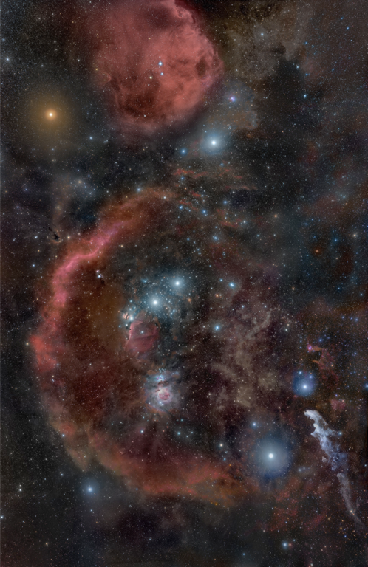
Orion – Nursery of Baby Stars

Slide 3
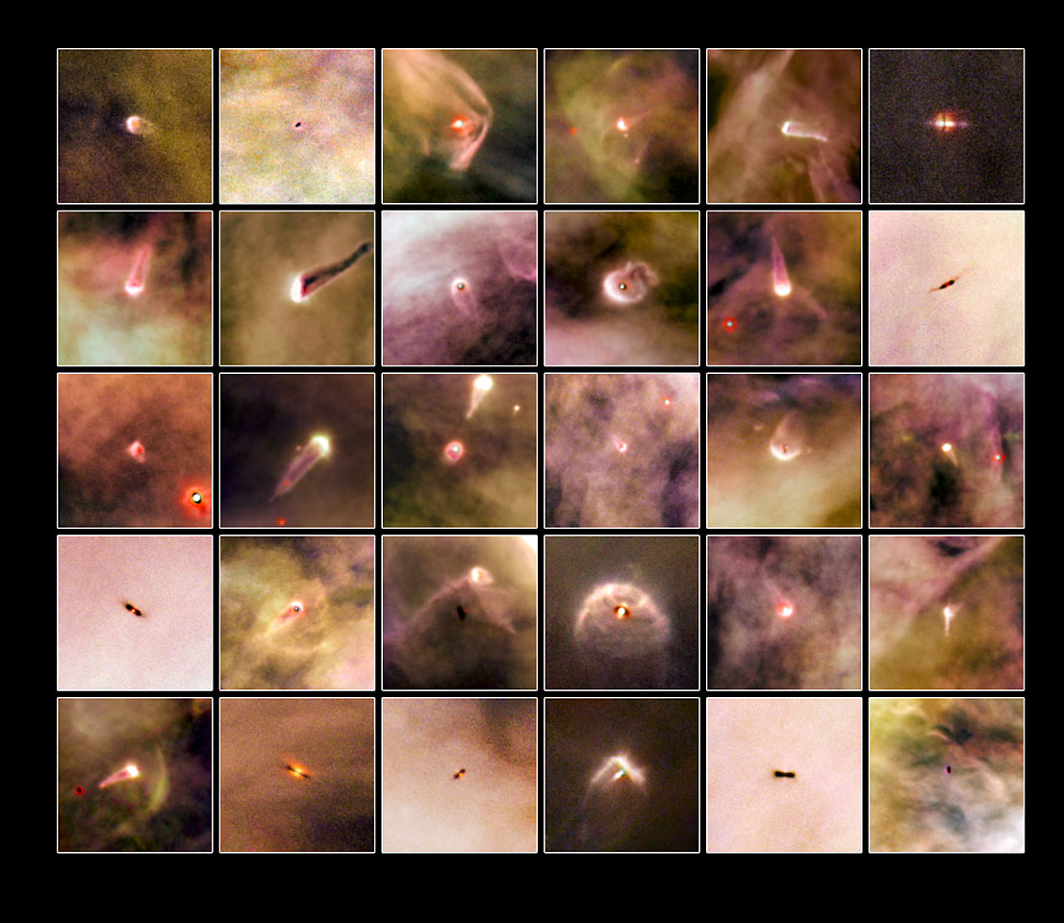
Why look in the Orion Nebula?
The Orion Nebula is a site of active star formation from O stars to planetary mass objects
Stars in Orion Nebula are ~1 Myr old (very young)
It’s hypothesized that our own solar system formed in a similar environment.
Silhouette disks provide us unique laboratory to study the dust in young planet forming disks.
Photo Courtesy of ESA/Hubble

Slide 4
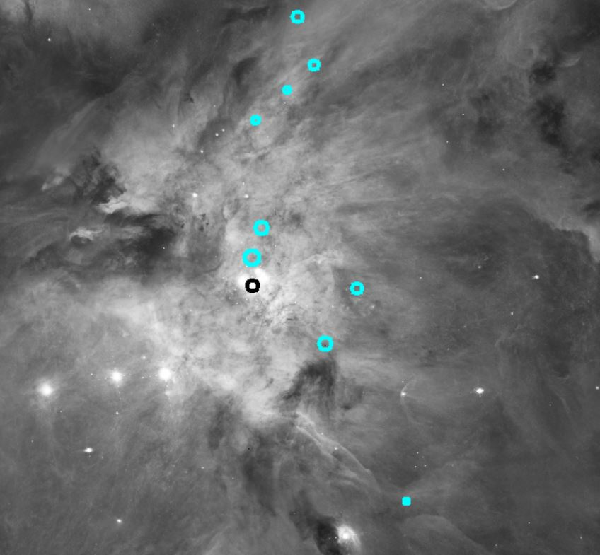
Silhouette Disks
132-1832
Distance: 1.81 light years
121-1925 Distance: 1.56 ly
163-026
Distance: 1.12 ly
140-1952
Distance: 1.35 ly
159-221
Distance: 0.394 ly
090-326
Distance: 0.703 ly
165-254
Distance: 0.184 ly
114-426
Distance: 0.632 ly
053-717
Distance: 1.81 ly
Notes:
What I want to mention on this slide: we wanted to analyze the physical properties and how their appearance changed in different filters
Arcsec*400 = unit of au
Au/206265. = in unit of pc
Pc -> light year (ly) *3.26

Slide 5
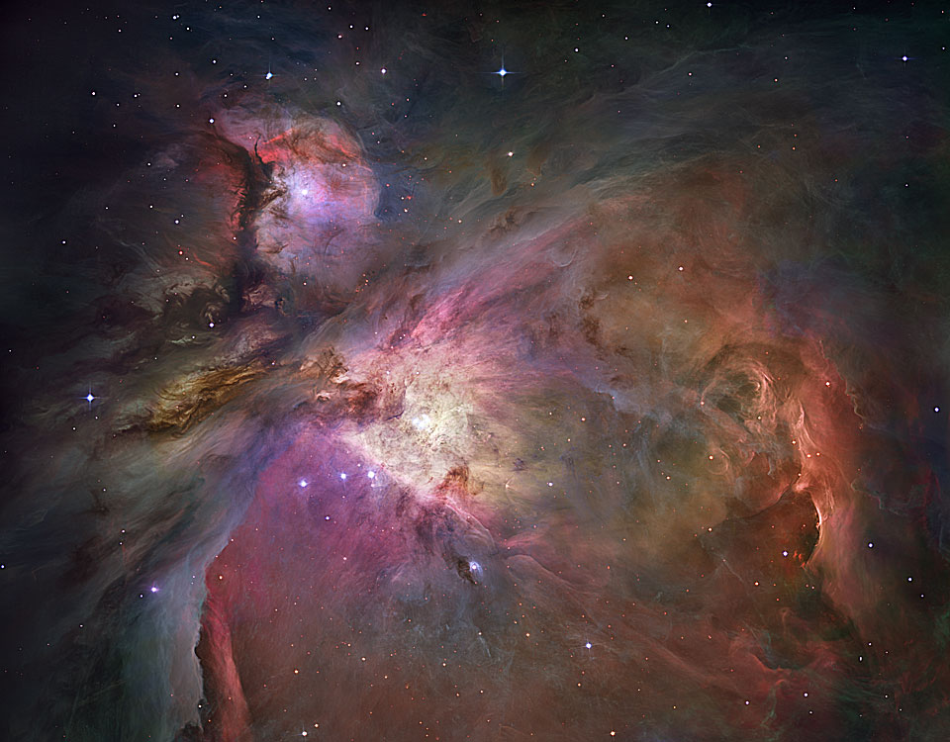
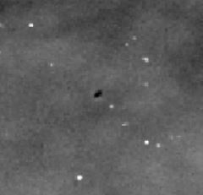
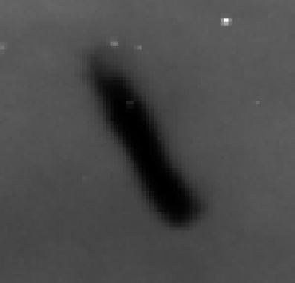
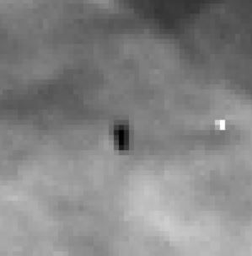
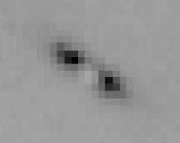
Silhouette Disks of interest in Orion Nebula
C
A
B
090-326
114-246
D
A
B
D
C
165-254
132-1832

Slide 6
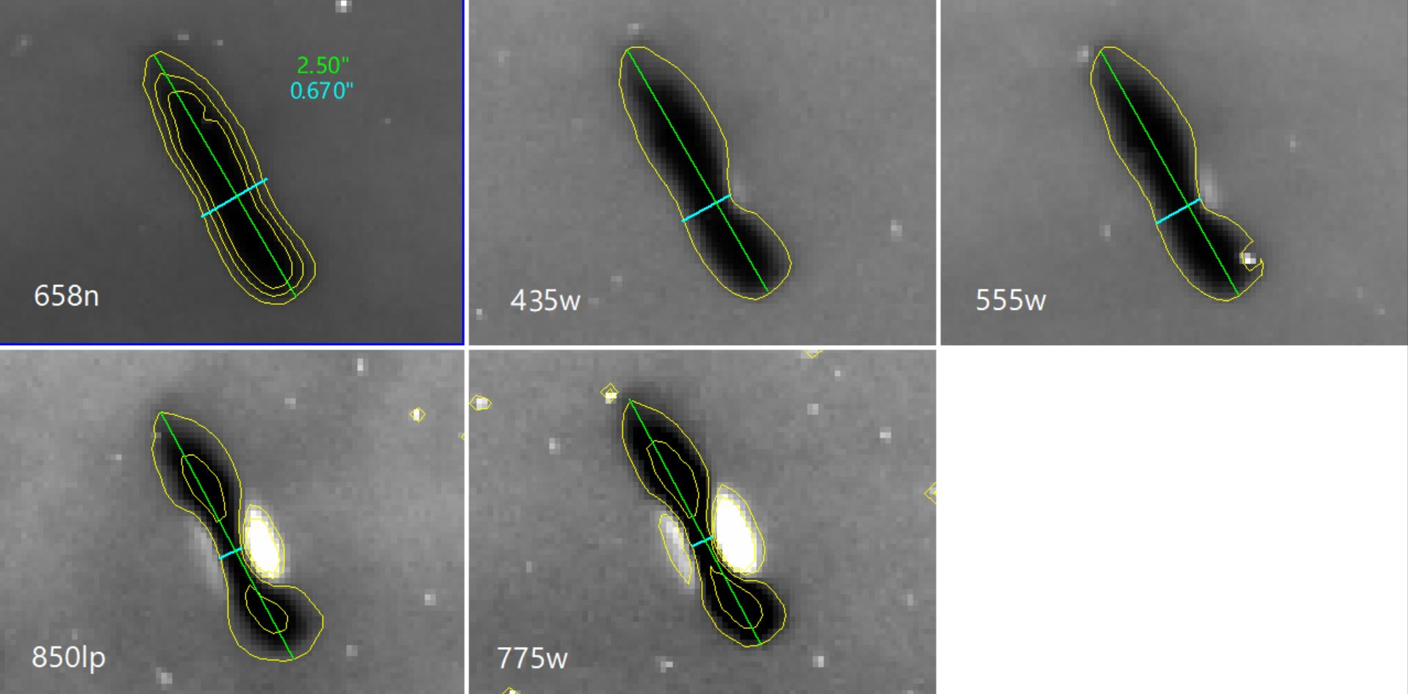
114-426
Interesting Points:
Disk was extremely large (~1000AU semimajor axis, 270 AU for semi minor axis).
Narrowing in the middle.
Notes:
Fonts are too small

Slide 7
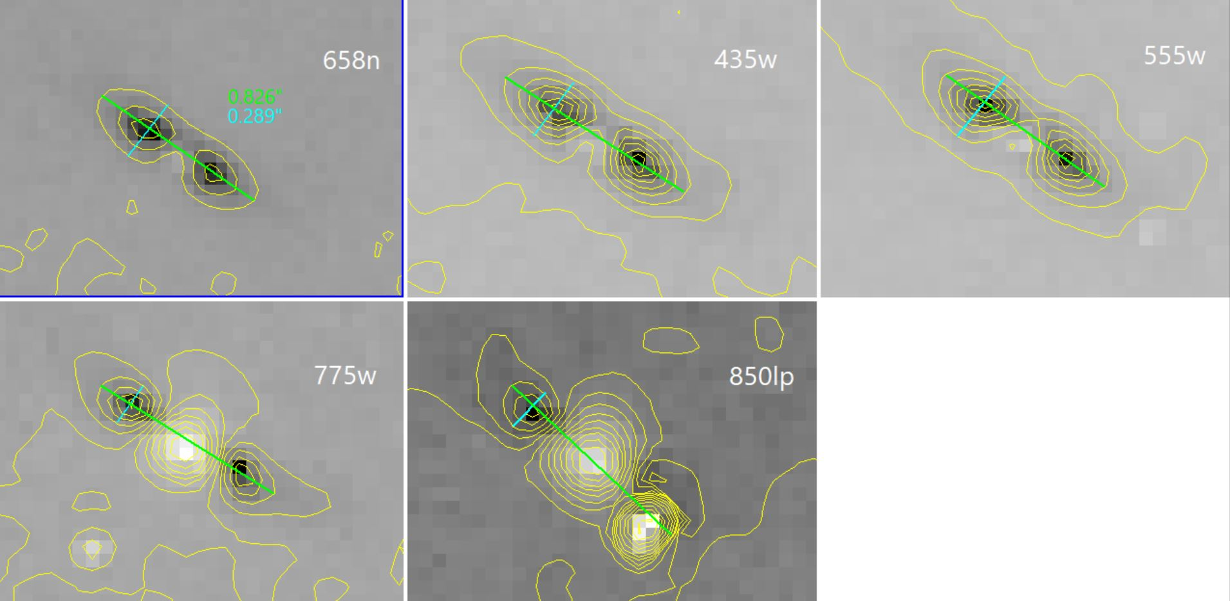
132-1832
Interesting Points:
Double lobed show that the dust is concentrated in the midplane.
Middle becomes pinched off in longer wavelengths.

Slide 8
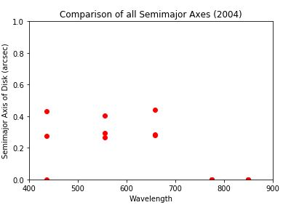
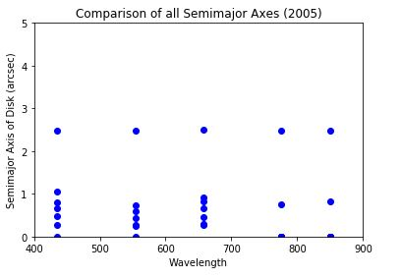
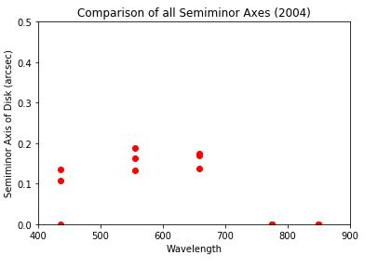
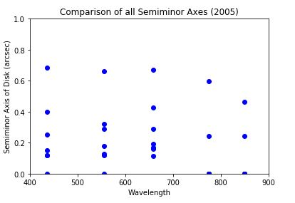
No overall trends were found
114-426 is an outlier (larger than the others)
Semi-Major axis and Semi-minor axis
Evidence of dust grain growth in the midplane of disk.
Notes:
3rd bullet is not because of physical reason but because of observational constraints.: Notice how there are few (or no) points at longer wavelengthre are few (or no) points at longer wavelengths

Slide 9
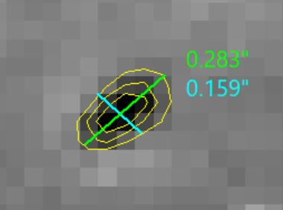
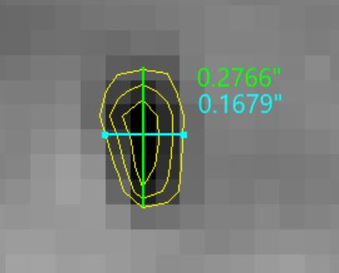
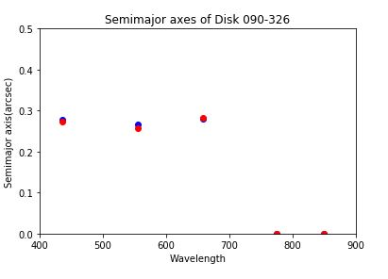
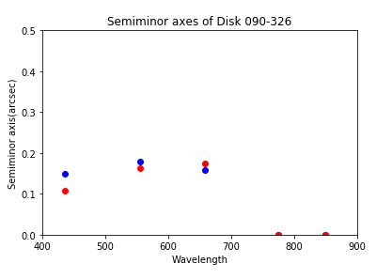
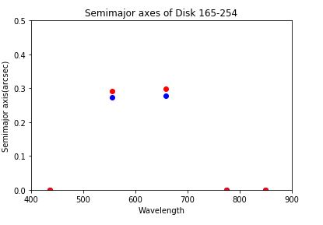
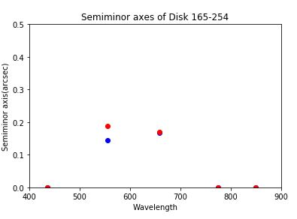
Variability in 090-326 and 165-254
Interesting Points:
Both disk show variability, but there is no connecting trend.
Dust is unobservable in longer wavelengths for both disks (too faint).
No measurement in shorter wavelength.
110 au
67 au
113 au
64 au

Slide 10
Conclusions and Further Work
Dust disk height gets smaller for longer wavelength image: Grain sizes appear to be getting larger in the midplane.
Because we are unable to see many of the disk in longer wavelengths, this puts a limit on the size of dust grains in the silhouette disks.
For future work I want to look more into the variability of the disks.
- Measuring opacity and intensity of the disks
- Look for more candidates to confirm the trends or modify
Notes:
look -> appear
Variability: say that you are already working on it

Slide 11
Thank You
Acknowledgements:
Hubble Legacy Archive
Ricci et. al (2008)
Miotello et all. (2016)

